Slide 1

Computing Algorithms Lecture 5: Brute force part 2
By: Dr. Mohamed Moheeb

Slide 2
Agenda
Closest-pair problem
Exhaustive search

Slide 3

Closest-pair problem

Slide 4
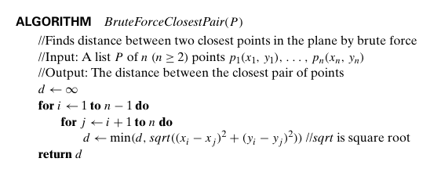
Closest-pair Problem
p1
p2
p4
Given that the input is 4 points shown in the figure
Initialize the distance by infinity
Variables
d=∞

Slide 5
Closest-pair Problem
p1
p2
p4
Initialize index i=1
Variables
d=∞
i=1

Slide 6
Closest-pair Problem
p1
p2
p4
Initialize index j to i+1 =2
Variables
d=∞
i=1
j=2

Slide 7
Closest-pair Problem
p1
p2
p4
Calculate the distance between pi and pj or p1 and p2
Compare between the Calculated distance (16) and d (∞) and set the min as the new d=16
Variables
d=16
i=1
j=2

Slide 8
Closest-pair Problem
p1
p2
p4
Increment j by 1
Variables
d=16
i=1
j=3

Slide 9
Closest-pair Problem
p1
p2
p4
Calculate the distance between pi and pj or p1 and p3
Compare between the Calculated distance (4) and d (16) and set the min as the new d=4
Variables
d=4
i=1
j=3

Slide 10
Closest-pair Problem
p1
p2
p4
Increment j by 1
Variables
d=4
i=1
j=4

Slide 11
Closest-pair Problem
p1
p2
p4
Calculate the distance between pi and pj or p1 and p3
Compare between the Calculated distance (10) and d (4) and set the min as the new d=4
Variables
d=4
i=1
j=4

Slide 12
Closest-pair Problem
p1
p2
p4
Increment j by 1 which exceed the value of n(4), then exit the inner loop
Variables
d=4
i=1
j=5

Slide 13
Closest-pair Problem
p1
p2
p4
Increment i=2
Variables
d=4
i=2

Slide 14
Closest-pair Problem
p1
p2
p4
Initialize index j to i+1 =3
Variables
d=4
i=2
j=3

Slide 15
Closest-pair Problem
p1
p2
p4
Calculate the distance between pi and pj or p2 and p3
Compare between the Calculated distance (20) and d (4) and set the min as the new d=4
Variables
d=4
i=2
j=3

Slide 16
Closest-pair Problem
p1
p2
p4
Increment j by 1
Variables
d=4
i=2
j=4

Slide 17
Closest-pair Problem
p1
p2
p4
Calculate the distance between pi and pj or p2 and p4
Compare between the Calculated distance (18) and d (4) and set the min as the new d=4
Variables
d=4
i=2
j=4

Slide 18
Closest-pair Problem
p1
p2
p4
Increment j by 1 which exceed the value of n(4), then exit the inner loop
Variables
d=4
i=2
j=5

Slide 19
Closest-pair Problem
p1
p2
p4
Increment i=3
Variables
d=4
i=3

Slide 20
Closest-pair Problem
p1
p2
p4
Initialize index j to i+1 =4
Variables
d=4
i=3
j=4

Slide 21
Closest-pair Problem
p1
p2
p4
Calculate the distance between pi and pj or p3 and p4
Compare between the Calculated distance (2) and d (4) and set the min as the new d=2
Variables
d=2
i=3
j=4

Slide 22
Closest-pair Problem
p1
p2
p4
Increment j by 1 which exceed the value of n(4), then exit the inner loop
Variables
d=2
i=3
j=5

Slide 23
Closest-pair Problem
p1
p2
p4
Increment i=4 which exceed the value of n-1 (3), then we exit the outer loop
Variables
d=2
i=4

Slide 24
Closest-pair Problem
p1
p2
p4
The closest pair distance value is equal to 2 and is returned
Variables
d=2

Slide 25
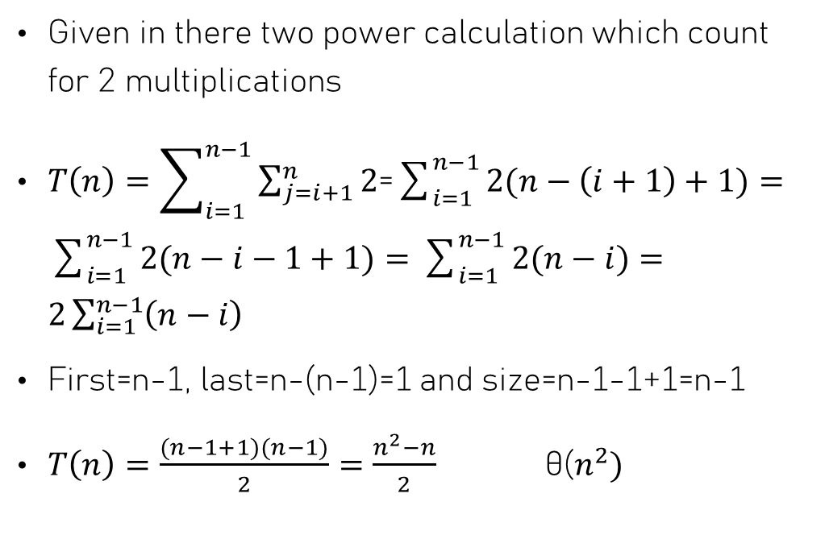
Closest-pair Problem
Given in there two power calculation which count for 2 multiplications
$T\left(n\right)=\sum_{i=1}^{n−1}{\sum_{j=i+1}^{n}{2}}$=$\sum_{i=1}^{n−1}{2(n−\left(i+1\right)+1})=\sum_{i=1}^{n−1}{2(n−i−1+1})=\sum_{i=1}^{n−1}{2(n−i)}=$ $2\sum_{i=1}^{n−1}{\left(n−i\right)}$
First=n-1, last=n-(n-1)=1 and size=n-1-1+1=n-1
$T\left(n\right)=\frac{(n−1+1)(n−1)}{2}=\frac{n^{2}−n}{2}$ θ($n^{2})$
2 multiplication

Slide 26
Exhaustive search

Slide 27
Exhaustive search
Tries every possible solution in the search space.
Guaranteed to find an optimal solution (if one exists).
Very simple to implement, but usually extremely slow.

Slide 28
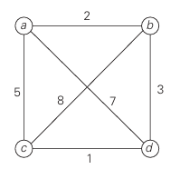
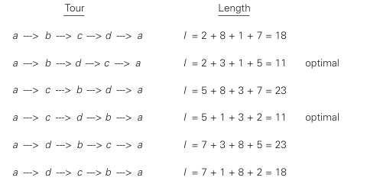
Traveling Salesman Problem
Book: Introduction to the Design and Analysis of Algorithms

Slide 29
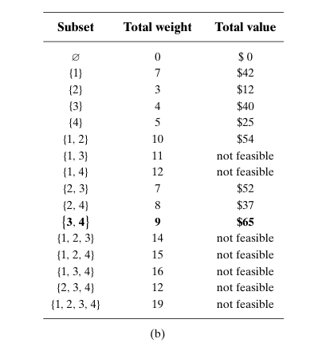
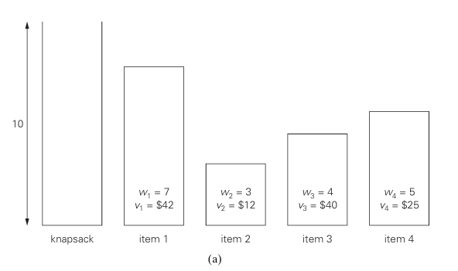
Knapsack problem
Book: Introduction to the Design and Analysis of Algorithms

Slide 30
Assigning Problem
 | Job 1 | Job 2 | Job 3
Person 1 | 1 | 2 | 10
Person 2 | 8 | 4 | 2
Person 3 | 4 | 5 | 6
<1,2,3>→ 1+4+6=11
<1,3,2>→1+2+5=8 best case
<2,1,3>→2+8+6=16
<2,3,1>→2+2+4=8 best case
<3,1,2>→10+8+5=23
<3,2,1>→10+4+4=18

Slide 31
NP-problems
All pervious problems are considered , exhaustive search leads to algorithms that are extremely inefficient on every input.
In fact, these three problems are the best-known examples of so-called NP-hard problems. No polynomial-time algorithm is known for any NP hard problem.
A polynomial-time algorithm is one whose runtime grows reasonably with input size (like n², n³, etc.).

Slide 32
NP-problems
For the Traveling Salesman Problem (TSP): You would try all possible routes between cities. Number of possible routes O(n!), which becomes huge extremely fast.
For the Knapsack Problem: You try all subsets of items. Number of subsets = 2ⁿ, which also grows exponentially
For the Assignment Problem: You try all possible n agents and n tasks, and you need to pair them up to minimize the total cost which is equal to O(n!)
If you try to calculate every possible permutation. For example, in assignment problem just 20 agents and 20 tasks, there are over 2 quintillion possibilities. Your computer would likely give up before you do.

